Slide 1
Imbalanced dataset classifier
Lili Wang

Slide 2
x₂
x₁

Slide 3
x₂
C2
C3
C4
C1
C5
C6
x₁

Slide 4
x₂
C2
C3
C4
C1
C5
C6
x₁

Slide 5
One problem of clustering

Slide 6
Frame of the algorithm
For( majority set is bigger than threshold) do
Randomly Discard some majority samples from the training set
Do clustering on the training set and find the pure set and train the classifier
Calculate F1 socres on validation set, if it is the best F1 score we ever seen, store the best model
And after the loop, we apply the best model on the test set

Slide 7
Baseline without SMOTE (F1)
 | HTRU2 | AID687 | AID688 | AID373 | AID604
Balanced ratio | 0.091574 | 0.002843 | 0.009205 | 0.000217 | 0.003546
Bernoulli naïve Bayes | 0.008 | 0 | 0 | 0 | 0
Knn | 0.838 | 0 | 0 | 0 | 0
Logistic regression | 0.874 | 0 | 0 | 0 | 0
Gaussian naïve Bayes | 0.745 | 0.006 | 0.018 | 0 | 0.008
Random forest | 0.871 | 0.02 | 0 | 0 | 0.077

Slide 8
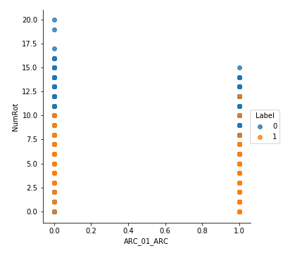
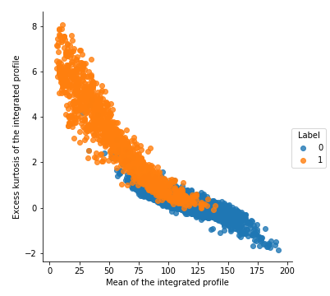
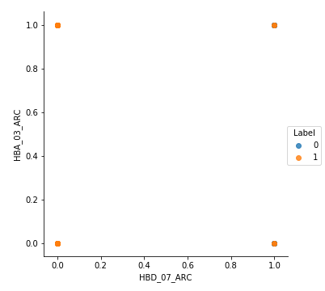
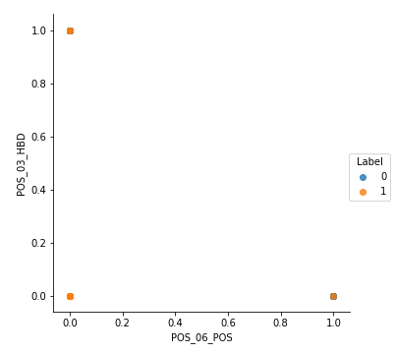
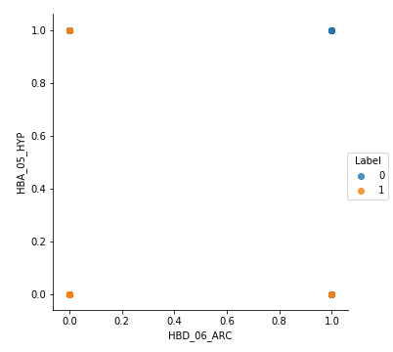
Data visualization
HTRU2
AID604
AID373
AID687
AID688

Slide 9
Baseline with SMOTE & New algorithm(F1)
 | HTRU2 | AID687 | AID688 | AID373 | AID604
Bernoulli naïve Bayes | 0.284 | 0.008 | 0.019 | 0.002 | 0.009
Knn | 0.703 | 0.010 | 0.019 | 0.004 | 0.015
Logistic regression | 0.840 | 0.011 | 0.022 | 0.005 | 0.022
Gaussian naïve Bayes | 0.730 | 0.006 | 0.018 | 0 | 0.008
Random forest | 0.856 | 0.041 | 0 | 0.1 | 0.084
New algorithm | 0.871 | 0.060 | 0.018 | 0.117 | 0.079

Slide 10
Future work
Formulate the parameters
Combined with SMOTE

